Slide 1
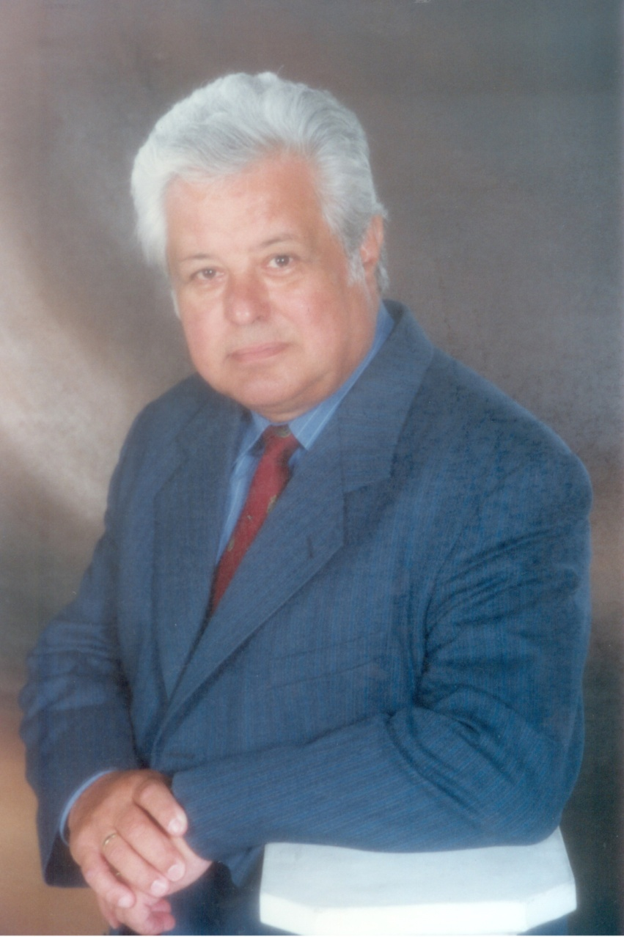
Professor László Halmy MD PhD DMSc
1935-2013
One of the most well-known key scientific opinion leader in Hungary
430 publications
45 on PubMed
More than 500
scientific lectures
More than 500
TV and radio
communications
From 1965
studied and
published obesity
as an internist,
Specializations:
neuroendocrinol.
endocrinology
epidemiology
hypertension
lipidology
hepatology
Organized 62 congresses
on obesity
CV:
www.laszlo.halmy.hu

